Slide 1

AGE 310: Instrumentation and Measurements
Lecture 3: Resistive Transducers
Instructor: Dr. Kadeghe Fue
Department of Agricultural Engineering
Sokoine University of Agriculture (SUA)

Slide 2


Recap & Objectives
Recap: Lecture 2
Lecture 3 Objectives
We covered Standards (Primary/Secondary), Traceability, and the difference between Analog and Digital signals (4-20mA loops).
Understand the principle of Resistance Change.
Analyze Potentiometers for displacement sensing.
Explore Strain Gauges and the Gauge Factor.
Apply the Wheatstone Bridge circuit.
Discuss Temperature sensors: RTDs vs Thermistors.

Slide 3


The Principle of Resistive Sensing
Many sensors work by changing their electrical resistance in response to a physical variable.
The resistance of a conductor is given by:
How Transducers Work:
Change L: Potentiometers (sliding contact).
Change A & L: Strain gauges (stretching wire).
Change ρ: Thermistors & LDRs (temperature/light affects material structure).
Where:
= Resistivity (Material property)
= Length of conductor
= Cross-sectional Area

Slide 4

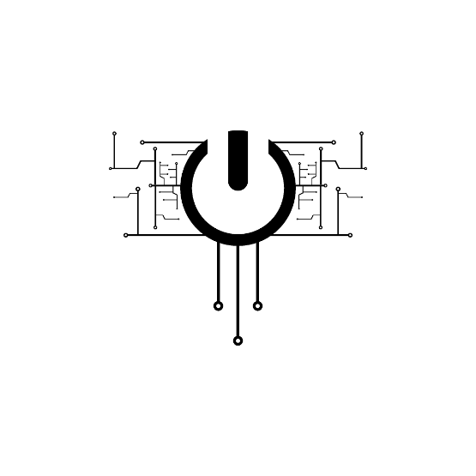
1. Potentiometers ("Pots")
Function
A passive resistive transducer that converts linear or angular displacement into a change in resistance.
Construction
Consists of a resistive element (wire wound or carbon track) and a movable contact (wiper).
Output: Voltage divider rule.

Slide 5







Types of Potentiometers
Linear Potentiometer
Rotary Potentiometer
Helipot (Multi-turn)
Measures linear distance.
Measures angular rotation.
High precision. The wiper moves along a helix.
Ag Use: Measuring hydraulic cylinder extension on a tractor loader.
Ag Use: Measuring the angle of a boom sprayer arm or steering wheel position.
Use: Precision laboratory controls.

Slide 6
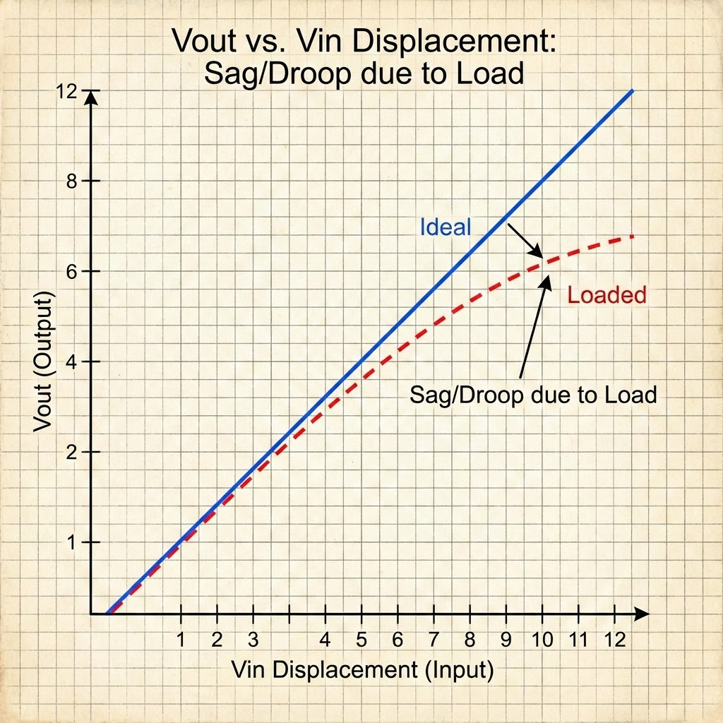

The Loading Effect Error
Ideally: The output voltage is perfectly linear.
Reality: When we connect a voltmeter or DAQ (load) to the output, current flows through the load.
This creates a parallel resistance path.
The relationship becomes non-linear.
Solution: Use a High-Impedance amplifier (buffer) or Op-Amp to minimize current draw.

Slide 7
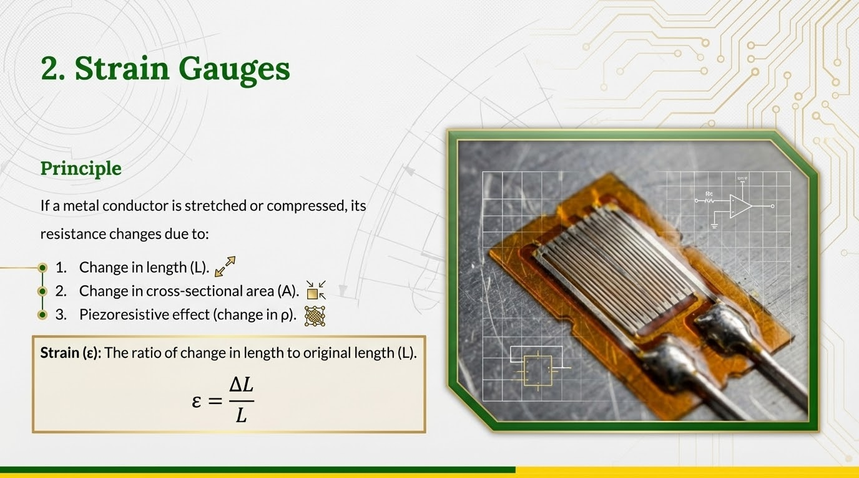

Slide 8
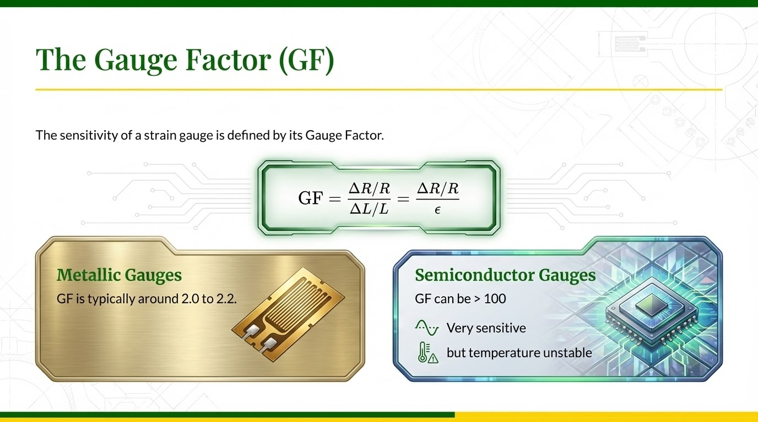

Slide 9

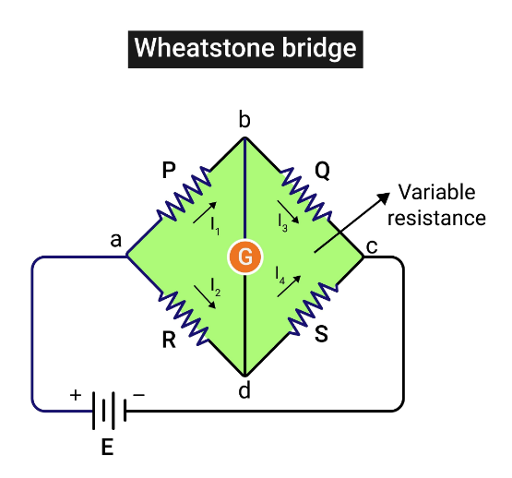
Measurement: The Wheatstone Bridge
The change in resistance ( ) in a strain gauge is extremely small (milliohms).
We cannot measure this with a standard multimeter.
Solution: The Wheatstone Bridge circuit converts small resistance changes into a measurable voltage change.

Slide 10

Bridge Configurations
Quarter Bridge
Half Bridge
Full Bridge
1 Strain Gauge, 3 Fixed Resistors.
2 Strain Gauges (one active, one dummy or measuring opposite strain).
4 Strain Gauges.
Most sensitive (4x output). Used in high-quality Load Cells.
Least sensitive, requires temperature compensation.
Better linearity, cancels temperature effects.

Slide 11
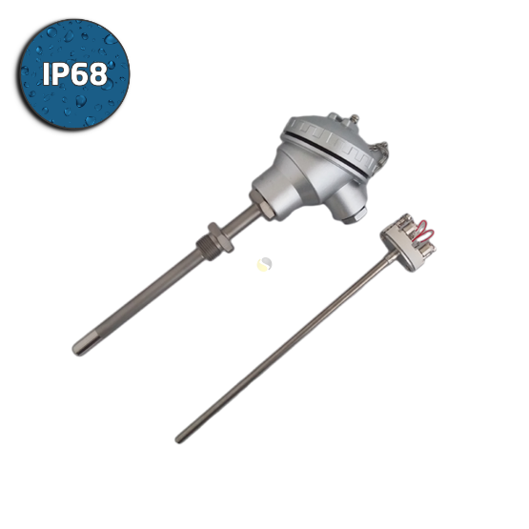
3. RTDs (Resistance Temperature Detectors)
Principle
Made of pure metals (Platinum, Nickel, Copper). Resistance increases linearly with temperature.
PT100: The industry standard. Platinum wire with 100Ω resistance at 0°C.
Known for high stability and accuracy.

Slide 12
4. Thermistors
NTC (Negative Temp. Coeff.)
PTC (Positive Temp. Coeff.)
Resistance decreases as temperature increases.
Resistance increases as temperature increases.
Most common for temperature sensing in cars and appliances.
Used as self-resetting fuses (overcurrent protection) in motors.

Slide 13
Comparison: RTD vs. Thermistor
Feature | RTD (Platinum) | Thermistor
Material | Pure Metal (Conductor) | Metal Oxide (Semiconductor)
Linearity | Very Linear (Positive Coeff) | Highly Non-Linear (Exponential)
Range | Wide (-200 to +850°C) | Narrow (-100 to +300°C)
Cost | Expensive | Cheap

Slide 14
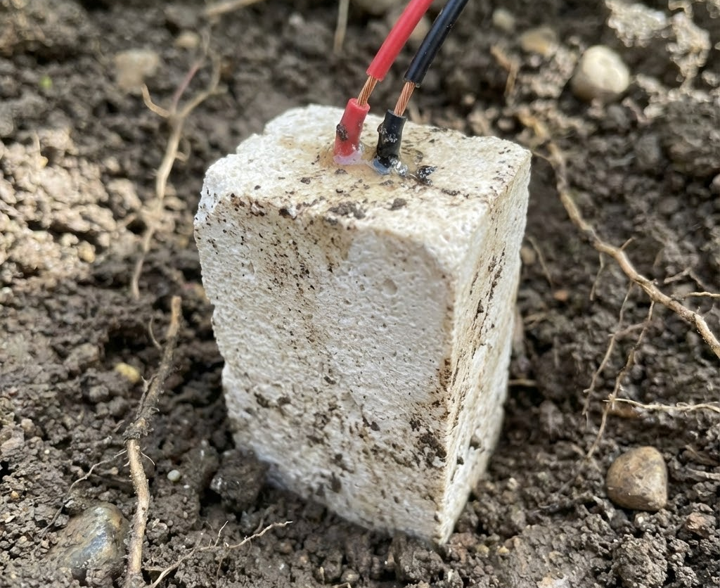
5. Resistive Soil Moisture Sensors
Gypsum Blocks
Two electrodes embedded in a block of gypsum.
Operation: The block absorbs water from the soil until equilibrium. As water content increases, resistance decreases.
Pros: Cheap, low maintenance.
Cons: Dissolves over time (1-3 years).

Slide 15
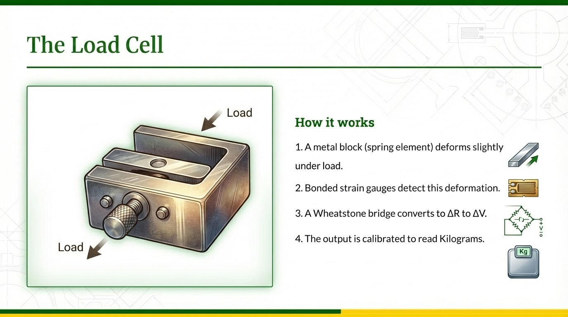

Slide 16
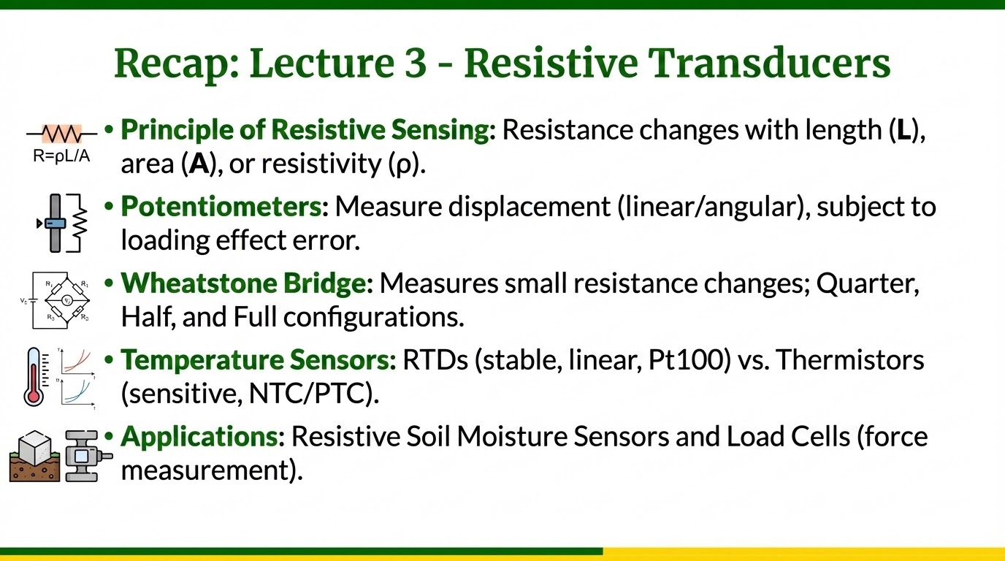

Slide 17

Questions?
End of Lecture 3
Next Class: Capacitive and Inductive Transducers (LVDTs and Capacitive Moisture Probes).
Dr. Kadeghe Fue | AGE 310 | SUA

